Slide 1
Image Representation and Printing
V. Masilamani

Slide 2
Outline
Definition of Digital Image
Representation of Colour Pixel values
RGB –for monitors
CMY -for printers
Image file
Printers
Halftone, Approximation of Halftone, Dither matrix based Halftone

Slide 3
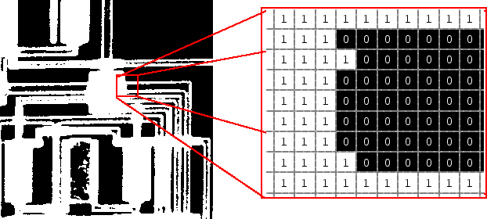
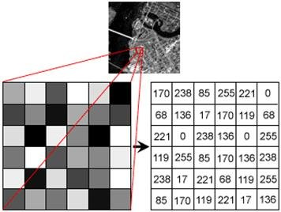
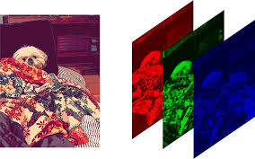
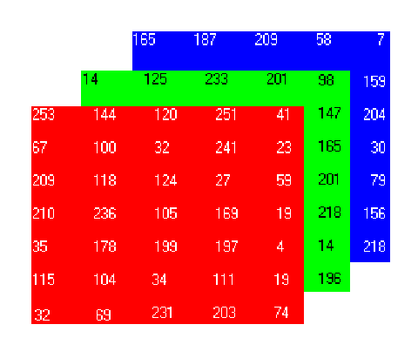
Definition of Digital Image
Gray Scale Digital image is a 2D array of integers from 0 to L-1
Binary Image is a gray scale image when L=2
L is called as number of gray levels
Colour Image is a sequence of three 2D arrays –each one for one of R,G,B

Slide 4
2D Coordinate System
X
X
X
Y
Co-ordinate system: (origin, axes)
2D-Left Hand co-ordinate system: (Used in DIP often)
Top-left cell of the image is origin (0,0)
+ve X axis is towards bottom from origin
+ve Y axis is towards right from origin
2D-Right Hand co-ordinate system: Used in Graphics often)
Bottom-left cell of the image is origin (0,0)
+ve X axis is towards right from origin
+ve Y axis is towards top from origin
(0,0)
1 | 1 | 1 | 1 | 1
0 | 0 | 1 | 0 | 0
0 | 0 | 1 | 0 | 0
0 | 0 | 1 | 0 | 0
X
Left Hand
Y
1 | 1 | 1 | 1 | 1
0 | 0 | 1 | 0 | 0
0 | 0 | 1 | 0 | 0
0 | 0 | 1 | 0 | 0
(0,0)
X
Right Hand

Slide 5
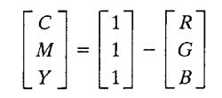
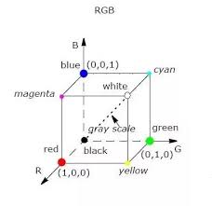
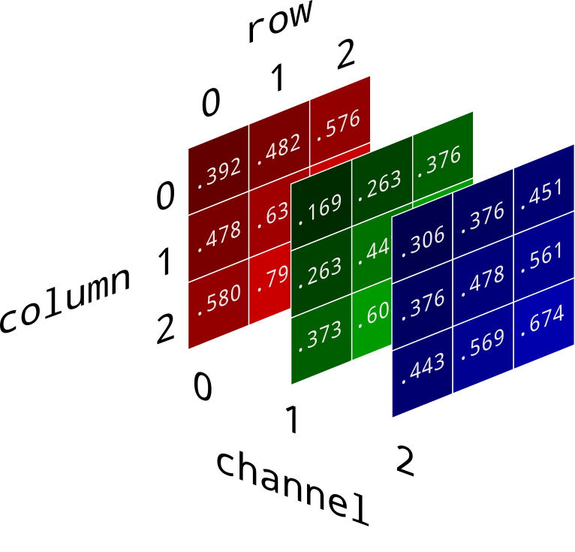
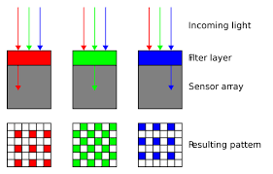
RGB to CMY Conversion
Printer scans image using RGB, but prints using CMY
In normalized colour image Values of R, G, B are in [0,1]
CMY Colour Model:

Slide 6
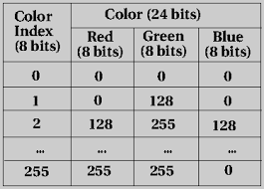
How to Represent Colour
Colour can be represented in any colour model such RGB or CMY etc.
Colour Representation using Direct coding : R: 0 to L1-1; G: 0 to L2-1; G: 0 to L3-1.
Total number of colours is L1xL2XL3
Our eye can not distinguish all colours when L1, L2 and L3 are large number
Colour representation using Lookup table:
Colour image is represented by single matrix M,
Where M[i][j] is an index of table entry
Image Storage will be less as only index is to
be stored(8 bits instead of 24 bits per pixel)

Slide 7
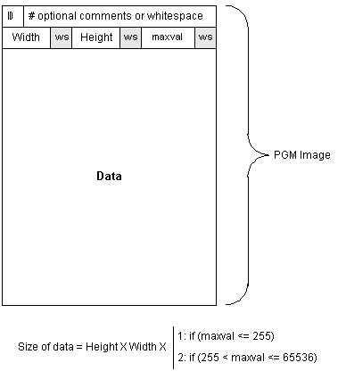
File Format
File format: The layout of image file
in storage/transmission -Header, Data
Different File format means different
compression scheme
The Header portion will have all info
required for de-compression
Data portion will have compressed data
Eg. Run Length Coding:
Input: 4 4 4 4 4 4 11 11 11 5 5 5 5
Compressed Image: (4,6), (11,3), (5,4)
Size of image file = size of data
+ size of header

Slide 8
Some Properties of Image
Size of gray scale image: The size of the 2D array that represents the image ie. No. of rows X No. of columns
Size of gray scale image in storage: No of rows X No of columns X No of bits required to represent one pixel
Size of gray scale image in display: M X N sqrinch
Size of Colour Image:
When Direct Coding is used: 3X No of rows X No of columns X No of bits required to store one pixel
When Lookup table is used: No of rows X No of columns X No of bits required to store index
Resolution of Image at display: No. of pixels per inch. - row and column directions

Slide 9
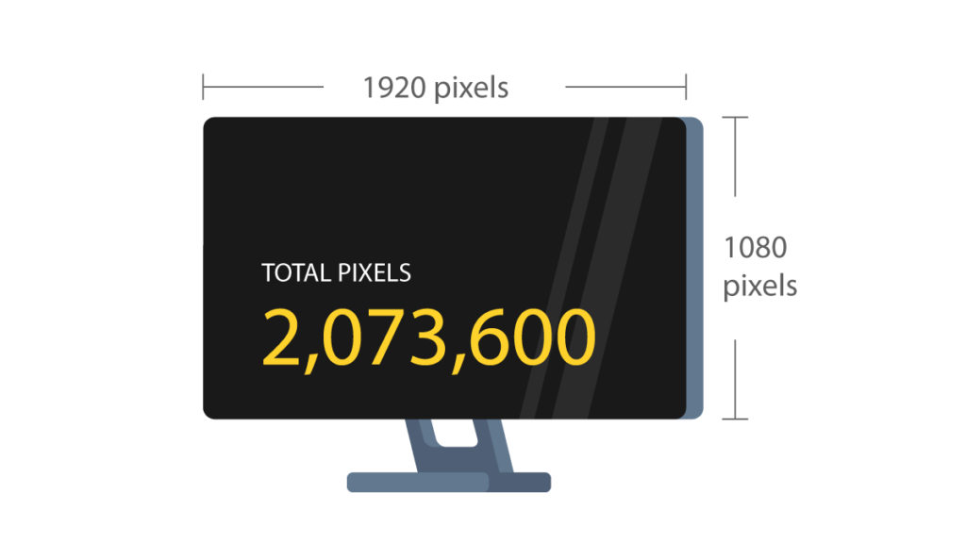
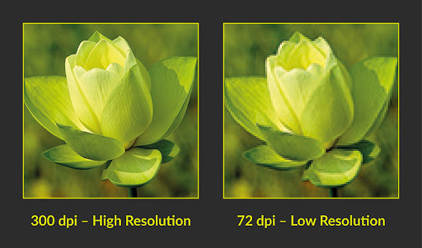
Some Properties of Image
Resolution of Image when image is captured: No. of pixels captured per inch captured by camera - row and column directions
When the same No. of pixels displayed on larger area, the resolution will become less

Slide 10
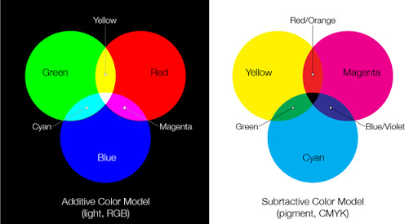
How image is displayed by Printers
Printers use CMYK colour model; K stands for black pigment
Printer Deposits colour pigments(CMYK) onto print media
When the light gets reflected from the pigments, we see colour
For Binary, only Black pigment is used
60-80 dots per inch is used in News paper
120-200 dots per inch is used in Magazine

Slide 11
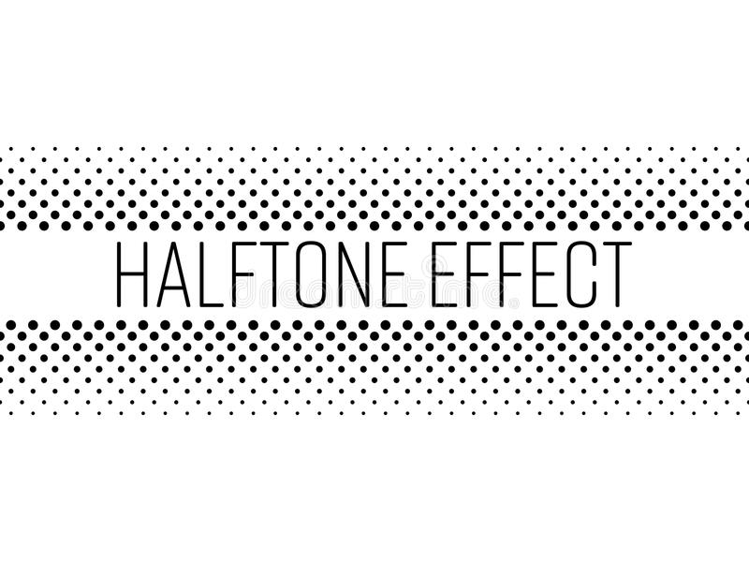
Halftone
Fulltone(printing continuously on medium) Vs Halftone(printing discrete dots)
To print gray scale image, only black pigment is used by employing Halftone technique
Halftone is a technique used by printers: Various tones of grey or colour are produced by variously sized dots of pigments.
To print darker shade: print larger dots
using black ink
To print lighter shade: print smaller dots
using black ink
Issue: Producing dots different size
is a challenging task
-Image with 256 level needs dots of 256 sizes

Slide 12
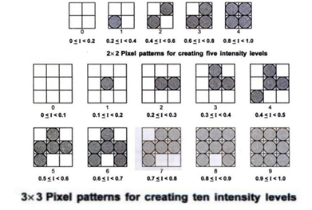
Halftone Approximation
Instead of changing dot size, halftone can be approximated using pixel-grid pattern
More the black dots, darker the pattern
Shades of gray is produced by the patterns
Instead of displaying larger dot in Halftone
method, display darker pattern in halftone
approximation method
When an image If(x,y) is to be printed,
print lighter pattern when I(x,y) is low
Issue: Resolution will decrease as display area increases:
if nXn image is displayed in aXb sqrinch using Halftone, then this halftone approximation will take 2aX2b sqrinch

Slide 13
Dithering
Dithering is a technique to approximate halftones, without reducing resolution
Dithering is done using a matrix called Dithering matrix
Let D_{n} be the Dithering matrix of size nXn
For every pixel, (x,y) in image f, find i= x mod n; j= y mod n
Display dot (Using black pigment) at (x,y) if f(x,y)>D(i,j)
Note that more the value of f(x,y), darker the pixel will be
Printer uses C=M=Y for gray, C=M=Y=1 means R=G=B=0
Halftone approximation can be done for colour images by using the same technique for each matrix

Slide 14
How is Dithering matrix used in printing
Printed Image
Image to be printed
Dither Matrix
.9 | .9 | .9 | 0
0 | 0 | .9 | 0
0 | 0 | .9 | 0
0 | 0 | .9 | 0
0 | .5
.75 | .25
.9 | .9 | .9 | .1
.1 | 0 | .9 | 0
0 | 0 | .9 | 0
0 | .2 | .9 | .2
0 | .5
.75 | .25

Slide 15
Floyd-Steinberg Error Diffusion Algorithm
i/p: Gray scale image f(x,y) to be printed, and Set of shades available with printing device
o/p: modified image f ’(x,y) with the property that the difference between f(x,y) and printed shade at (x,y) is distributed to the neighbouring pixels
S1) Copy f to f ’
S2) for each pixel (x,y),
e= f ’(x,y)-P(x,y), where P(x,y) is the value(shade) printed at (x,y) (P(x,y) is the nearest input shade to f ’(x,y))
find f ’(x+1, y) =f ’(x+1,y) +ae ; find f ’(x+1, y+1) =f ’(x+1,y+1) +be
find f ’(x, y+1) =f ’(x, y+1) +ce ; where a=c=3/8 and b=2/8 (Origin is top-left pixel of array)
Note: Different neighbourhood and also different values for weights are allowed

Slide 16
How Colour Printer Works
For each pixel (i,j), Colour value in CMY model will be available in memory
One display medium, to print each pixel (i,j), three closely spaced dots with C,M,Y ink will be applied
As those three dots are very close, when the light reflected from those dots, we will see a single colour
To print each of C, M, Y, the same technique followed for gray scale image is used
Such as halftone, approximation to halftone etc.

Slide 17
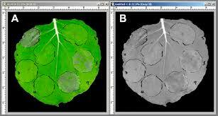
Conversion from Colour to Gray
Suppose colour image is available in memory, and the printer that attempts to print is gray scale printer -colour to gray conversion is required
Let colour image f(x,y)=(r(x,y), g(x,y), b(x,y))
The corresponding gray scale image
f ’(x,y)=(r(x,y)+g(x,y)+b(x,y))/3
Or
f ’(x,y) = 0.299 r(x,y) + 0.587 g(x,y) + 0.114 b(x,y)

Slide 18
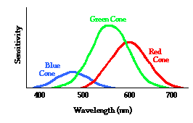
Why Green Colour is given more importance
Eye is more sensitive to Green, less sensitive to Red, least sensitive to Blue

Slide 19
Some Problems
What is the resolution of 2 X 2 inch image that has 512 X 512 pixel
Ans: 512 pixels per inch
If an image has a height of 2 inches and an aspect ratio of 1.5 , find its width
Ans: 3 inches
If we use 2 byte pixel values in a 24-bit lookup table representation, how many bytes does the lookup table occupy?
Ans: 2^16 X 24/8
HW: 1) Given a pixel p at the location (x,y) of image with M X N pixels using left handed system, find the coordinates of p, say (x’, y’) in right handed system
2) If we use direct coding for RGB values with 10 bits per primary colour, how many possible colours do we have for each pixel?

